Slide 1
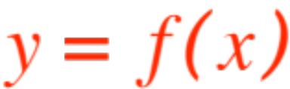
CONTINUITY
The man-in-the-street understanding of a continuous process is something that proceeds smoothly, without breaks or interruptions.
Consequently, for a function to be called “continuous”, we would expect its graph to be a smooth line, without breaks or interruptions.

Slide 2
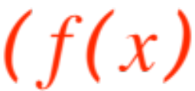
Let’s look at some graphs we would definitely not call continuous ; the best way to define “day” is
to think of “night”, “happy” is meaningless unless
you know “sad”, most concepts are better understood via their opposites !
Here is a function whose graph you would definitely not call continuous, it jumps at every integer!
The formal definition of is

Slide 3
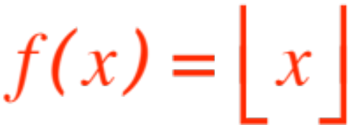

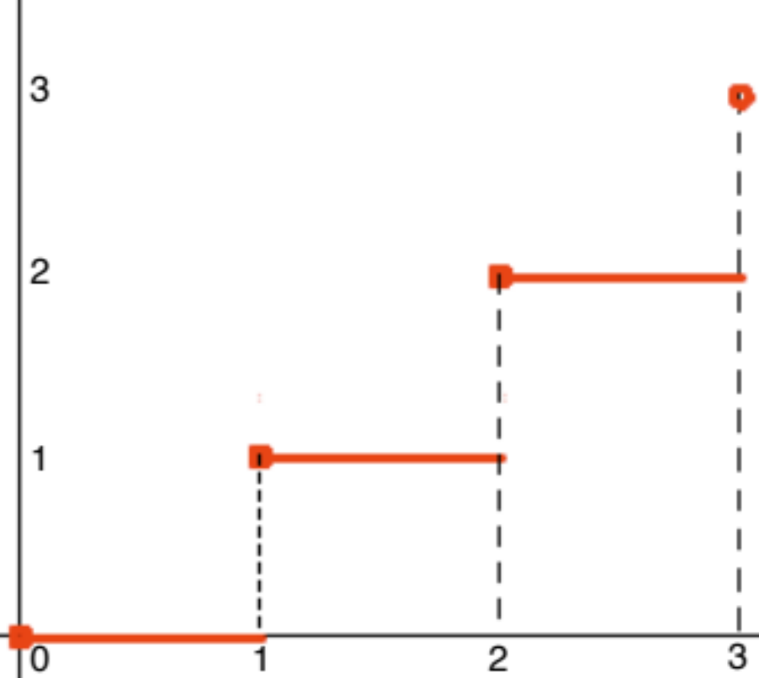
(The notation is somewhat different from the textbook’s, it means the greatest integer ≤ )
Here is the graph

Slide 4
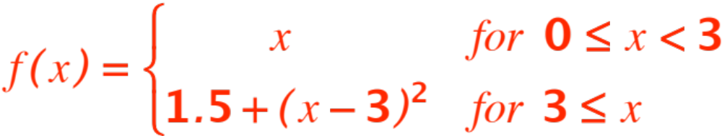
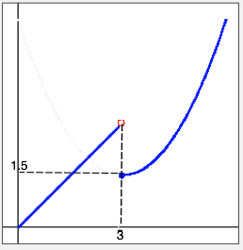
There’s a break at every integer! What’s the trouble? Here is another

Slide 5
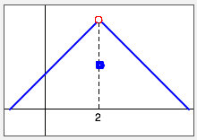
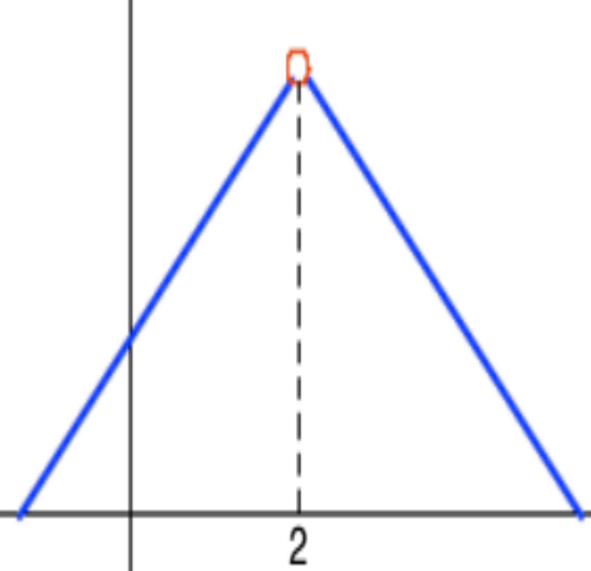
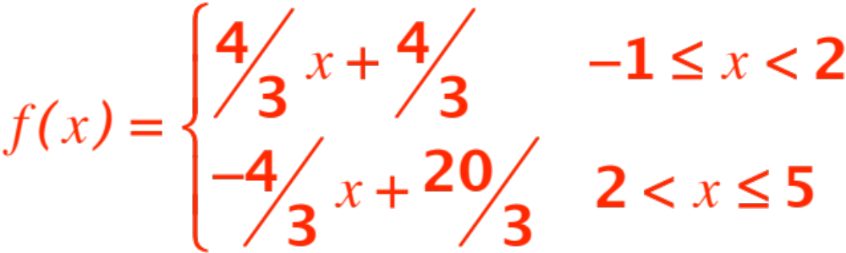
A break at 3 again! Two more graphs.

Slide 6
A hole at 2 !
On the right the hole has been incorrectly filled.
The next example is the messiest.

Slide 7
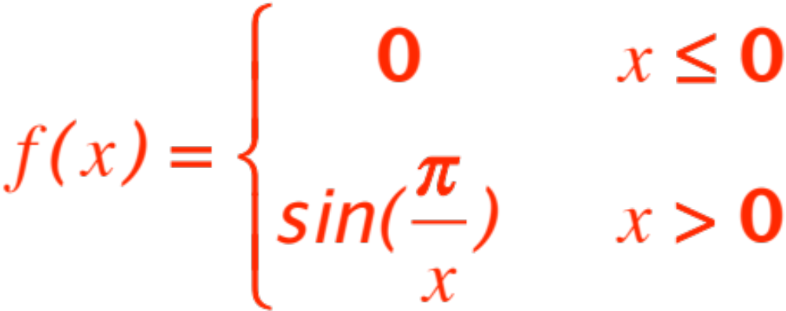
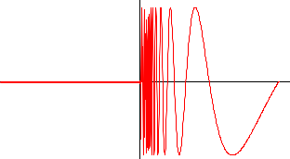

Slide 8
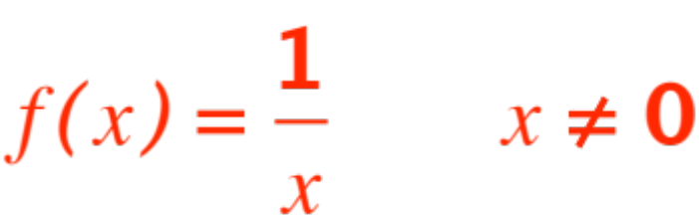
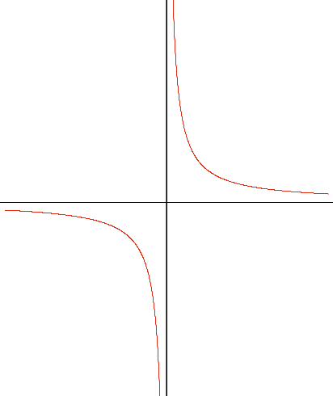
Talk about not smooth! A little better:

Slide 9
What do these pictures tell us about our intuitive notion of a continuous graph?
There should be:
No holes
No jumps
No uncertainties.
To a mathematician these mean:

Slide 10
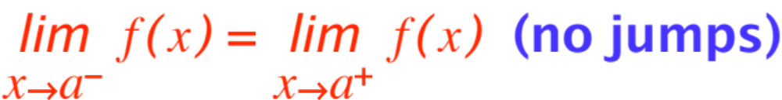
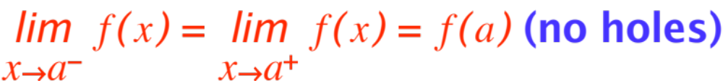
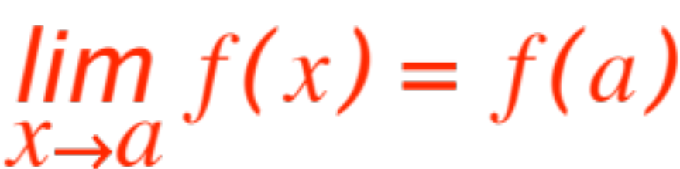
(the order is mixed up.)
These three are condensed in:
And formally:

Slide 11

CONTINUITY AT
Definition. The function is said to
be continuous at if
(all three previous conditions are assured by this statement.)
Now by application of the three statements

Slide 12
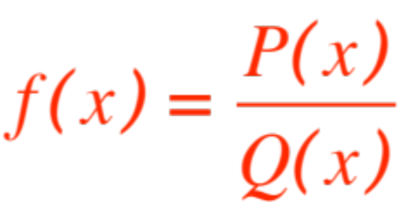
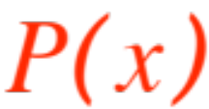
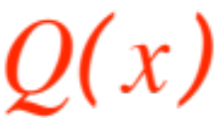
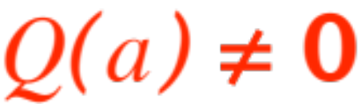

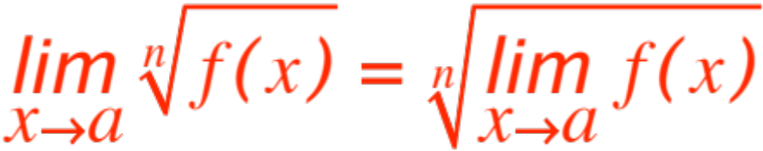
No. 1 If , where and
are polynomials, and then
we get that
every rational function is continuous at every point where it is defined.
No. 2 (usual caveat about n) gives us that

Slide 13
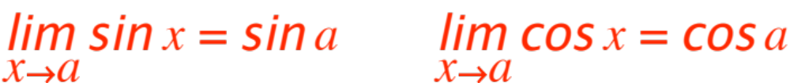




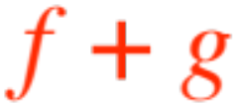
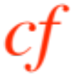
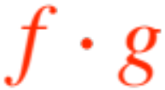
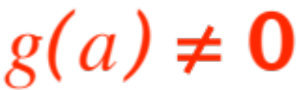
radicals of continuous functions are continuous wherever the are defined.
Finally, from
No.3
We get that
All trigonometric functions are continuous wherever they are defined.
Finally, if and are continuous at
then so are , , and if

Slide 14
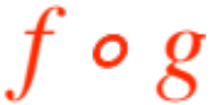
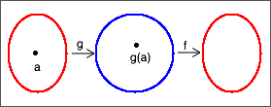


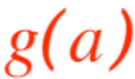
What about the composition ?
A look at this picture tells us that
If is continuous at and is continuous
at then is continuous at

Slide 15
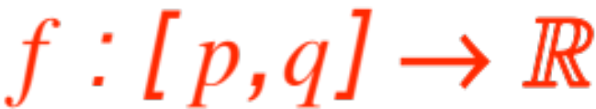
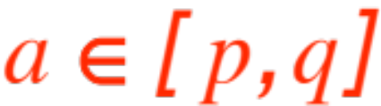
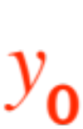
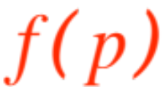
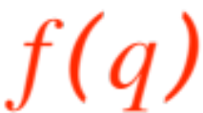
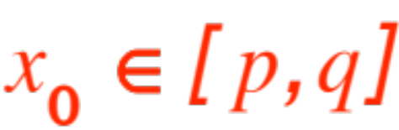
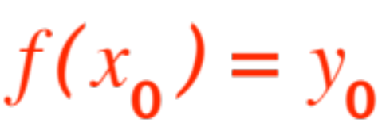
Intermediate Value Theorem
Probably the most important (useful) property of continuous functions is the following
Theorem. If is continuous at every , then for every number
between and there is at least one such that
A picture will help:
Notes:
Picture not ready, Example 5, p. 88, 42, p. 92,

Slide 16
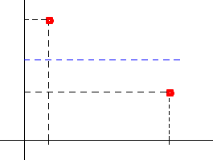





Here is the situation:

Slide 17
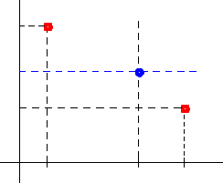

You can’t join the two red dots “continuously without crossing the blue dotted line.

